Slide 1

Amity University, Madhya Pradesh
Session: 2023 – 2025
Branch: MCA (2nd Semester)
MMP260 –> Minor Project - I
Topic : Jarvis Personalized Desktop Voice Assistance
Presentation
Supervisor
Presented By:
Dr. Ashok Kumar Shrivastava
Associate Professor (ASET)
Pankaj Baraiya
Enrolment No. – A620145023009

Slide 2
Contents
Introduction
Tools & Technologies
System Requirements
Objective
Modules/Libraries Used
Implementation
Tasks
Advantages/Disadvantages
Scope of the project
Conclusion
References

Slide 3
INTRODUCTION
Have you ever wondered how cool it would be to have your own assistant? Imagine how easier it would be doing Wikipedia searches without opening web browsers, and performing many other daily tasks like playing music with the help of a single voice command, opening different browsers in just a voice command. This project is simple desktop voice assistant built with python named as “Jarvis Desktop Voice Assistant”. This project is fully completed and error free. It was compiled in VS Code Editor.
A virtual assistant, also called an AI assistant or digital assistant, is an application program that understands natural language voice commands and completes tasks for the user. The whole concept based on how can we make our life easier or how can we automate the things by just using our voice command. When the project is being executed then first of all it greets the user as per the time. After that it just listen your command in form of voice and just that that thing according to your command.
It is implemented in “PYTHON Programming Language” in which implementation is very easy. For every sort of work there is module present in python which makes the thing very easy and effective to do. It is user friendly and easy to understandable for new user.

Slide 4


Tools & Technologies
.
Version : 3.8.3
Version : 1.55.2
SYSTEM REQUIREMENTS
OS : Windows 7 or above
RAM : 4GB or above
Hard Drive : 250 MB HDD
Processor : Intel Dual Core

Slide 5
OBJECTIVE
To Become familiar with the concepts of Python Language.
To Implement the concepts of basic and intermediate python operations for making this project used in real life.
To become familiar with different modules and libraries.
To make easy for the users to automate the things by using own voice commands.

Slide 6
Moules/Libraries Used
Pyttsx3
A python library that will help us to convert text to speech. In short, it is a text-to-speech library.
It works offline, and it is compatible with Python 2 as well as Python 3.
Datetime
To provide current or live time to Assistant.
Used for greeting user according to time.
Speech Recognition
Library for performing speech recognition, with support for several engines and APIs, online and offline.
Used for taking input from microphone as a source to perform tasks.
Wikipedia
Wikipedia is a Python library that makes it easy to access and parse data from Wikipedia.
It helps the user to get results for a particular query or search.

Slide 7
Web Browser
The web browser module provides a high-level interface to allow displaying Web-based documents to users
Under most circumstances, simply calling the open() function from this module will do the right thing.
OS
The OS module in Python provides functions for interacting with the operating system.
This module provides a portable way of using operating system-dependent functionality.
Random
We can generate random numbers in Python by using random module.
These are pseudo-random number as the sequence of number generated depends on the seed.
PyAutoGui
Pyautogui is a library that allows you to control the mouse and keyboard to do various things.
In this project we use this library for taking screenshots of the screen.

Slide 8
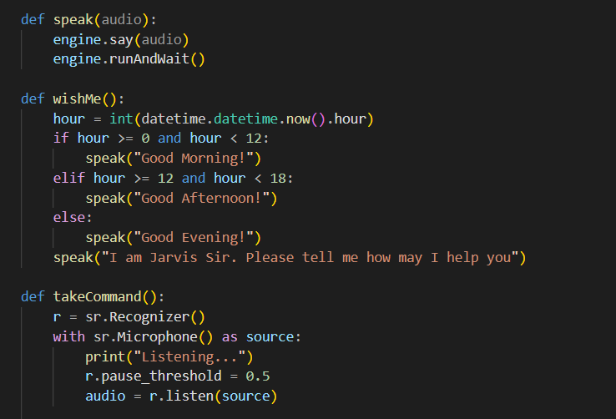
Implementation
Firstly our assistance greet us according to time stamp and then it will asks you to give command to perform

Slide 9
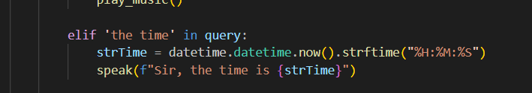
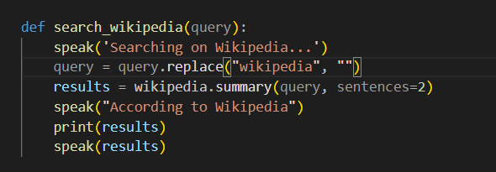
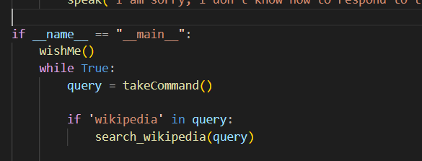
Task 1 :
Calling Time() and Date() Functions
Task 2 :
Searching on “Wikipedia” the particular elif statement become true and run the command said by user

Slide 10
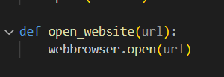
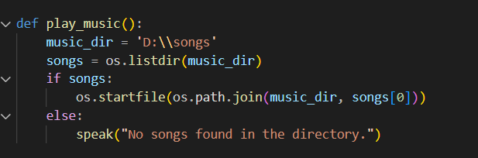
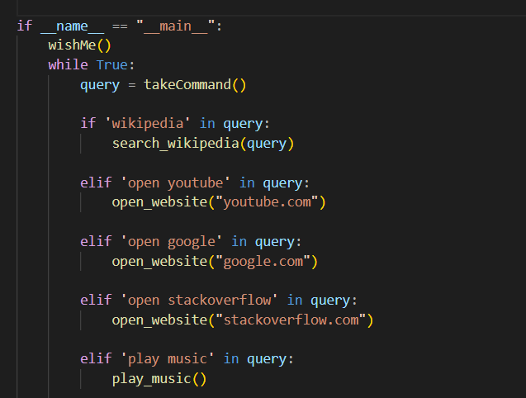
Task 2 :
To open “Website” and “Play Music”
After speaking “open YouTube” & “open Stack Overflow” the following sites open in browser

Slide 11
Advantages:
Disadvantages:
Easy to use
Can work with variety of commands
Custom commands
Helpful for disabled
Artificial intelligence make advancement in it.
Limited language support
Costly
Expensive equipment's
It cannot work in noisy environment
Can’t use for many numbers of people

Slide 12
Scope of the project
Presently, Jarvis is being developed as an automation tool and virtual assistant. Among the Various roles played by Jarvis are:
Search Engine with voice interactions
Medical diagnosis with Medicine aid.
Reminder and To-Do application.
Vocabulary App to show meanings and correct spelling errors.
Weather Forecasting Application.
There shall be proper Documentation available on its Official GitHub repository for making further development easy and we aim to release our virtual assistant as an Open Source Software where modifications and contributions by the community are warmly welcomed.

Slide 13
Conclusion
Through this voice assistant, we have automated various services using a single line command. It eases most of the tasks of the user like searching the web, retrieving weather forecast details, vocabulary help and medical related queries.
We aim to make this project a complete server assistant and make it smart enough to act as a replacement for a general server administration. The future plans include integrating Jarvis with mobile using React Native to provide a synchronized experience between the two connected devices.
Further, in the long run, Jarvis is planned to feature auto deployment supporting elastic beanstalk, backup files, and all operations which a general Server Administrator does. The functionality would be seamless enough to replace the Server Administrator with Jarvis.

Slide 14


